Slide 1
Program Name goes here
Link to github Repository: Github
Links to trello board / project management tools: Trello Board
You MUST provide evidence showing how the problem has been decomposed, how the components have been developed and trialled, and of how they have been assembled and tested to create a final, working outcome.

Slide 2
Describe your client
Briefly describe the online store
My online store will be a website where people are able to buy Jewellery. This website would give customers the opportunity to buy amazing Jewellery and be given the choice to either pick it up or have it shipped to them. This website will give them the opportunity to buy jewellery for loved ones, friends or even just for themselves.
What do they sell?
On my online store, it will sell many things such as rings, necklaces, bracelets and many more exciting things.
Who is the target market?
The market target would be young people

Slide 3
Relevant Implications
You must have at least 3. You can have more if you feel you need to consider more.

Slide 4
Explain the relevant implications
Implication 1
Describe the implication – Privacy
Privacy is an important implication because when customers enter their personal information such as phone number or address, they want to be sure that their information wouldn't get out to the public and have strangers know their personal information.

Slide 5
Explain the relevant implications
Implication 1
Explain why it needs to be considered
This implication needs to be considered because sometimes customers may need their items delivered/ shipped to them and that requires their personal information such as their address. With this type of information being given, my website would need to be able to keep this information private for the safety of the customer and not let personal information get out to the public.

Slide 6
Explain the relevant implications
Implication 1
Explain how you plan to address the implication
I plan to address this implication by testing my website multiple times to make sure my website works in a good way that it can keep people's information private and not let it get out.

Slide 7
Explain the relevant implications
Implication 2
Describe the implication - Social
This implication is about how the website will come across to customers such as is the website gender neutral? Is my website going to be formal or informal which in this case it would be formal because it is a business and we want the store to come across good. Social as a implication would also mean that my store would need to be appropriate for my attended audience which are young people.

Slide 8
Explain the relevant implications
Implication 2
Explain why it needs to be considered

Slide 9
Explain the relevant implications
Implication 2
Explain how you plan to address the implication

Slide 10
Explain the relevant implications
Implication 3
Describe the implication - Functionality

Slide 11
Explain the relevant implications
Implication 3
Explain why it needs to be considered

Slide 12
Explain the relevant implications
Implication 3
Explain how you plan to address the implication

Slide 13
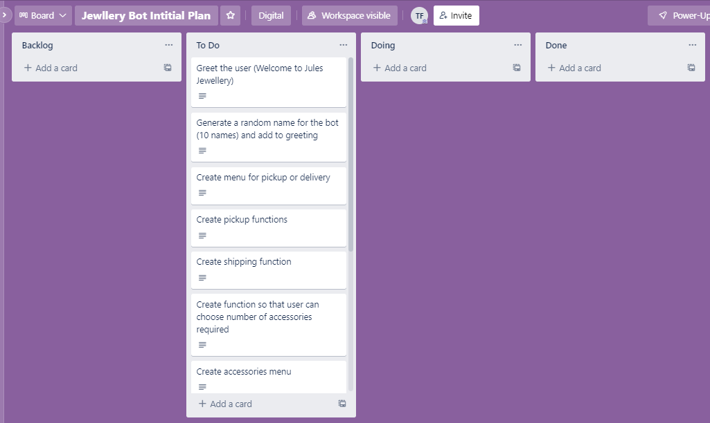
Decomposition
Notes:
Paste screenshots of your initial Trello board / task decomposition on this slide. If you have a long list, you might need to break it up into several columns. Delete this instruction when you are done.

Slide 14
Component Section
Duplicate Slides so that you have TRELLO and a TEST for each component

Slide 15
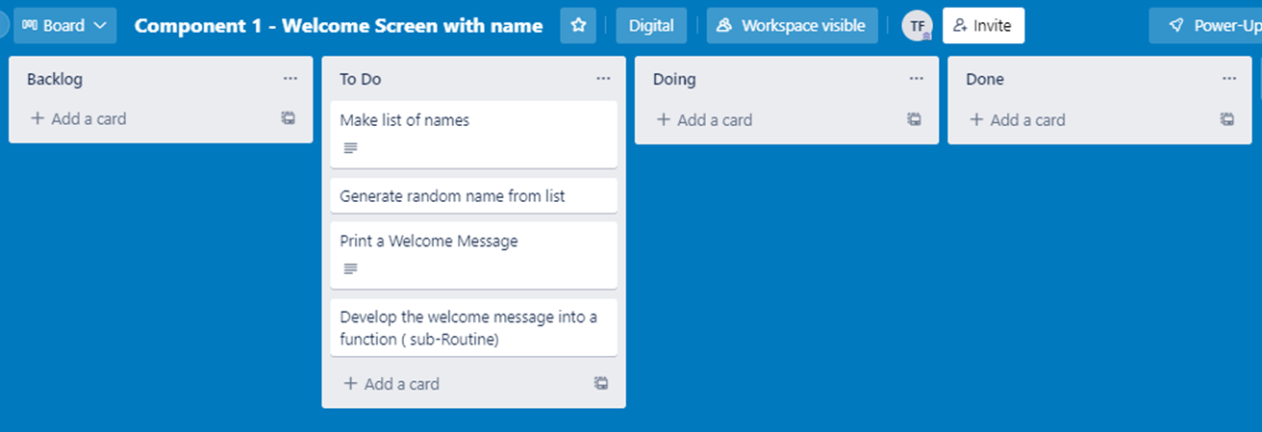
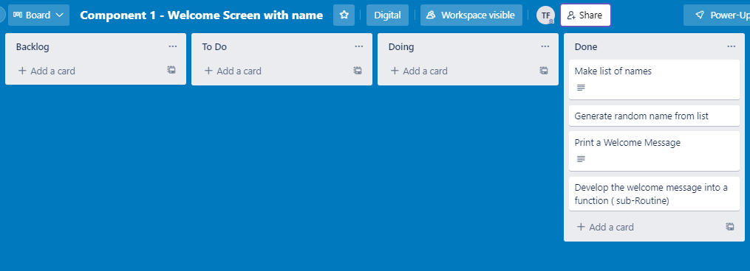
Component 1 (Trello screenshot) Version 1 Version 2

Slide 16
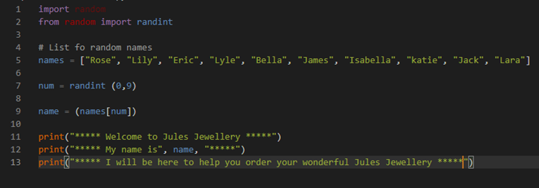
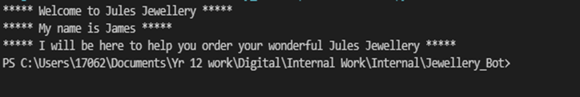
Component 1 - Test Plan (?and screenshot)
Test Case | Expected Values
Run Program | Print welcome message with random name from list of names – Runs correctly

Slide 17
Component 2 (Trello screenshot)

Slide 18
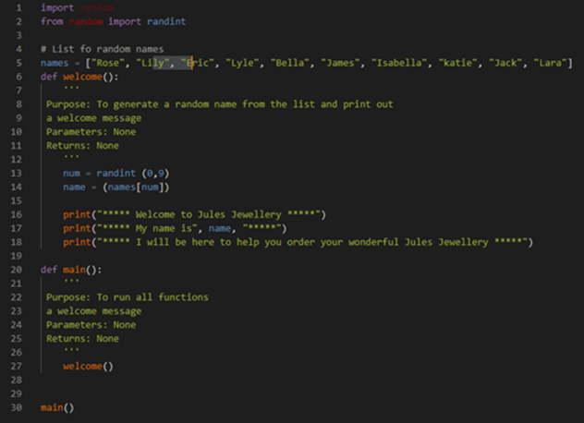
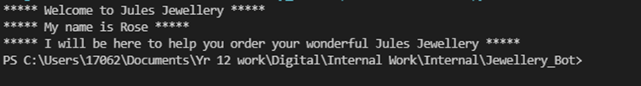
Component 2 - Test Plan (?and screenshot)
Test Case | Expected Values
Run Program | Main and welcome run correctly. Welcome message prints with random name.

Slide 19
Component 3 (Trello screenshot)

Slide 20
Component 3 - Test Plan (?and screenshot)
Test Case | Expected Values

Slide 21
Component 4 (Trello screenshot)

Slide 22
Component 4 - Test Plan (?and screenshot)
Test Case | Expected Values

Slide 23
Component 5 (Trello screenshot)

Slide 24
Component 5 - Test Plan (?and screenshot)
Test Case | Expected Values

Slide 25
Component 6 (Trello screenshot)

Slide 26
Component 5 - Test Plan (?and screenshot)
Test Case | Expected Values

Slide 27
Testing Section
Duplicate Slides and show how you tested and refined the program

Slide 28
Functional Testing (Screenshot and explain how you tested your program – use the testing template)

Slide 29
Using evidence of testing show how you refined your program (duplicate slides)

Slide 30
User Testing (Screenshot and show feedback from a range of users/testers)

Slide 31
Using evidence of user feedback show how you refined your program (duplicate slides)

Slide 32
Version Control Section Section
Duplicate Slides if required – Show screenshot of GitHub commits and comments

Slide 33
Version Control Evidence
Your version control evidence should go here. This could be in the form of annotated screenshots which show you you managed this process or you could make a brief screencast explaining how you implemented version control.
Notes:
Your version control evidence should go here. This could be in the form of annotated screenshots which show you you managed this process or you could make a brief screencast explaining how you implemented version control.

Slide 34
Python Code Coventions
Show screenshot of PEP8 testing both before and after.

Slide 35
Python convention testing (PEP8)
Screenshot of errors
Notes:
Your version control evidence should go here. This could be in the form of annotated screenshots which show you you managed this process or you could make a brief screencast explaining how you implemented version control.

Slide 36
Python convention testing (PEP8)
Screenshot after errors fixed
Notes:
Your version control evidence should go here. This could be in the form of annotated screenshots which show you you managed this process or you could make a brief screencast explaining how you implemented version control.

Slide 37
Discusses how the information from planning, testing and trialling of components assisted in the development of a high-quality outcome
Notes:
Discusses how the information from planning, testing and trialling of components assisted in the development of a high-quality outcome

